Slide 1

CSE214 – Analysis of Algorithms PhD Furkan Gözükara, Toros University https://github.com/FurkanGozukara/Analysis-of-Algorithms-2019
Lecture 8
Dynamic Programming
Based on Cevdet Aykanat’s and Mustafa Ozdal’s Lecture Notes - Bilkent

Slide 2
Introduction
An algorithm design paradigm like divide-and-conquer
“Programming”: A tabular method (not writing computer code)
Older sense of planning or scheduling, typically by filling in a table
Divide-and-Conquer (DAC): subproblems are independent
Dynamic Programming (DP): subproblems are not independent
Overlapping subproblems: subproblems share sub-subproblems
In solving problems with overlapping subproblems
A DAC algorithm does redundant work
Repeatedly solves common subproblems
A DP algorithm solves each problem just once
Saves its result in a table
Notes:
redundant

Slide 3














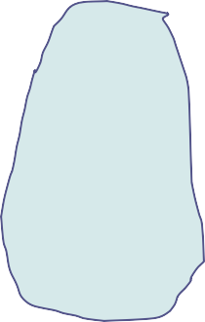
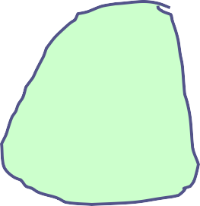


Example: Fibonacci Numbers (Recursive Solution)
Reminder:
F(0) = 0 and F(1) = 1 F(n) = F(n-1) + F(n-2)
10
8
9
REC-FIBO(n)
if n < 2
return n
else
return REC-FIBO(n-1)
+ REC-FIBO(n-2)
8
7
7
6
Overlapping subproblems in different recursive calls. Repeated work!

Slide 4

Example: Fibonacci Numbers (Recursive Solution)
Recurrence:
T(n) = T(n-1) + T(n-2) + 1
➔ exponential runtime
Recursive algorithm inefficient because it recomputes the same F(i) repeatedly in different branches of the recursion tree.

Slide 5






Example: Fibonacci Numbers (Bottom-up Computation)
Reminder:
F(0) = 0 and F(1) = 1 F(n) = F(n-1) + F(n-2)
8
7
6
5
4
3
2
1
ITER-FIBO(n)
F[0] = 0
F[1] = 1
for i = 2 to n do
F[i] = F[i-1] + F[i-2]
return F[n]
0
Runtime:Θ(n)

Slide 6
Optimization Problems
DP typically applied to optimization problems
In an optimization problem
There are many possible solutions (feasible solutions)
Each solution has a value
Want to find an optimal solution to the problem
A solution with the optimal value (min or max value)
Wrong to say “the” optimal solution to the problem
There may be several solutions with the same optimal value

Slide 7
Development of a DP Algorithm
Characterize the structure of an optimal solution
Recursively define the value of an optimal solution
Compute the value of an optimal solution in a bottom-up fashion
Construct an optimal solution from the information computed in Step 3

Slide 8
Example: Matrix-chain Multiplication
Input: a sequence (chain) ⟨A₁,A₂, … , A_{n}⟩ of n matrices
Aim: compute the product A₁·A₂·… ·A_{n}
A product of matrices is fully parenthesized if
It is either a single matrix
Or, the product of two fully parenthesized matrix products surrounded by a pair of parentheses.
(A_{i}(A_{i+1}A_{i+2} … A_{j}))
^{((A}i^{A}i+1^{A}i+2 ^{… A}j-1^{)A}j⁾
((A_{i}A_{i+1}A_{i+2} … A_{k})(A_{k+1}A_{k+2} … A_{j}))
for i≤k<j
– All parenthesizations yield the same product; matrix product is associative
Notes:
Associative ilişkili

Slide 9
Matrix-chain Multiplication: An Example Parenthesization
• Input: ⟨A₁, A₂, A₃, A₄⟩
5 distinct ways of full parenthesization
(A₁(A₂(A₃A₄)))
(A₁((A₂A₃)A₄))
((A₁A₂)(A₃A₄))
((A₁(A₂A₃))A₄)
(((A₁A₂)A₃)A₄)
The way we parenthesize a chain of matrices can have a dramatic effect on the cost of computing the product

Slide 10















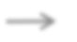
Reminder: Matrix Multiplication
A
B
C
MATRIX-MULTIPLY(A, B)
if cols[A]≠rows[B] then error(“incompatible dimensions”)
for i ←1 to rows[A] do
for j←1 to cols[B] do
C[i,j] ← 0
for k←1 to cols[A] do
C[i,j]← C[i,j]+A[i,k]·B[k,j]
return C
p
x
=
p
q
r
r
rows(A) = p cols(A) = q
rows(B) = q cols(B) = r
rows(C) = p cols(C) = r

Slide 11
Reminder: Matrix Multiplication
MATRIX-MULTIPLY(A, B)
if cols[A]≠rows[B] then error(“incompatible dimensions”)
for i ←1 to rows[A] do
for j←1 to cols[B] do
C[i,j] ← 0
for k←1 to cols[A] do
C[i,j]← C[i,j]+A[i,k]·B[k,j]
return C
A: p x q B: q x r
C: p x r
# of mult-add ops
= rows[A] x cols[B] x cols[A]
# of mult-add ops = p x q x r

Slide 12









Matrix Chain Multiplication: Example
A₁: 10x100 A₂: 100x5 A₃: 5x50
Which paranthesization is better? (A₁A₂)A₃ or A₁(A₂A₃)?
5
5
A₁A₂
100
A₁
# of ops: 10 . 100 . 5
= 5000
10
x
100
=
10
A₂
5
A₁A₂
50
A₁A₂A₃
# of ops: 10 . 5 . 50
= 2500
50
5 A₃
10
x
=
10
Total # of ops: 7500

Slide 13





Matrix Chain Multiplication: Example
A₁: 10x100 A₂: 100x5 A₃: 5x50
Which paranthesization is better? (A₁A₂)A₃ or A₁(A₂A₃)?
5 50
50
5 A₃
# of ops: 100 . 5 . 50
= 25000
100
x
=
100
A₂ A₂A₃
50
100
A₁
# of ops: 10 . 100 . 50
= 50000
50
A₁A₂A₃
10
x
100
A A
=
10
2 3
Total # of ops: 75000

Slide 14
Matrix Chain Multiplication: Example
A₁: 10x100 A₂: 100x5 A₃: 5x50
Which paranthesization is better? (A₁A₂)A₃ or A₁(A₂A₃)?
In summary:
(A₁A₂)A₃ ➔ # of multiply-add ops: 7500 A₁(A₂A₃) ➔ # of multiple-add ops: 75000
➔ First parenthesization yields 10x faster computation

Slide 15
Matrix-chain Multiplication Problem
Input: A chain ⟨ A₁,A₂, … , A_{n} ⟩ of n matrices, where A_{i} is a p_{i−1}×p_{i} matrix
Objective: Fully parenthesize the product
A₁ ·A₂·… ·A_{n}
such that the number of scalar mult-adds is minimized.

Slide 16
Counting the Number of Parenthesizations
Brute force approach: exhaustively check all parenthesizations
P(n): # of parenthesizations of a sequence of n matrices
We can split sequence between k^{th} and (k+1)^{st} matrices for any k=1, 2, … , n−1, then parenthesize the two resulting sequences independently, i.e.,
(A₁A₂A₃ … A_{k})(A_{k+1}A_{k+2} … A_{n})
We obtain the recurrence
n−1
P(1) = 1 and P(n) =∑P(k )P(n − k )
k =1

Slide 17
n−1
Number of Parenthesizations: ∑ P(k )P(n − k )
k =1
The recurrence generates the sequence of Catalan Numbers
Solution is P(n) = C(n−1) where
1
2n n
C(n) =
= Ω(4^{n}/n^{3/2})
n+1
The number of solutions is exponential in n
Therefore, brute force approach is a poor strategy

Slide 18
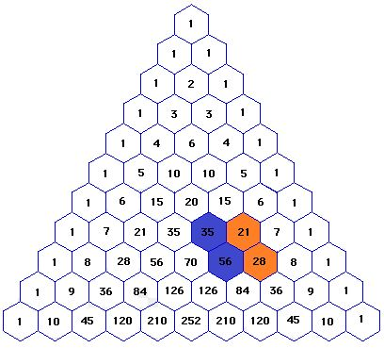
Catalan Numbers Example

Slide 19
The Structure of Optimal Parenthesization
Notation: A_{i..j}: The matrix that results from evaluation of the product: A_{i} A_{i+1} A_{i+2} … A_{j}
Observation: Consider the last multiplication operation in any parenthesization: (A₁ A₂ … A_{k}) . (A_{k+1} A_{k+2} … A_{n})
There is a k value (1 ≤ k < n) such that:
First, the product A_{1..k} is computed Then, the product A_{k+1..n} is computed Finally, the matrices A_{1..k} and A_{k+1..n} are
multiplied

Slide 20
Step 1: Characterize the Structure of an Optimal Solution
An optimal parenthesization of product A₁A₂…A_{n} will be:
(A₁ A₂ … A_{k}) . (A_{k+1} A_{k+2} … A_{n}) for some k value
The cost of this optimal parenthesization will be:
Cost of computing A_{1..k}
+ Cost of computing A_{k+1..n}
+ Cost of multiplying A_{1..k} . A_{k+1..n}

Slide 21

Step 1: Characterize the Structure of an Optimal Solution
Key observation: Given optimal parenthesization
(A₁A₂A₃ … A_{k}) · (A_{k+1}A_{k+2} … A_{n})
Parenthesization of the subchain A₁A₂A₃ … A_{k}
Parenthesization of the subchain A_{k+1}A_{k+2} … A_{n} should both be optimal
Thus, optimal solution to an instance of the problem contains optimal solutions to subproblem instances
i.e., optimal substructure within an optimal solution exists.

Slide 22
Step 2: A Recursive Solution
Step 2: Define the value of an optimal solution recursively in terms of optimal solutions to the subproblems
Assume we are trying to determine the min cost of computing A_{i..j}
m_{i,j}: min # of scalar multiply-add operations needed to compute A_{i..j}
Note: The optimal cost of the original problem: m_{1,n}
How to compute m_{i,j} recursively?

Slide 23

Step 2: A recursive Solution
Base case: m_{i,i} = 0 (single matrix, no multiplication)
Let the size of matrix A_{i} be (p_{i-1} x p_{i})
Consider an optimal parenthesization of chain A_{i} … A_{j}: (A_{i} … A_{k}) . (A_{k+1} … A_{j})
^{m}i,j ^{= m}i,k ^{+ m}k+1, j ^{+ p}i-1 ^{x p}k ^{x p}j
The optimal cost:
where:
m_{i,k}: Optimal cost of computing A_{i..k} m_{k+1,j}: Optimal cost of computing A_{k+1..j}
p_{i-1} x p_{k} x p_{j} : Cost of multiplying A_{i..k} and A_{k+1…j}

Slide 24
Step 2: A Recursive Solution
In an optimal parenthesization:
k must be chosen to minimize m_{ij}
The recursive formulation for m_{ij}:
0
if i=j
m_{ij} =
MIN{m_{ik} + m_{k+1, j} +p_{i−1}p_{k} p_{j}} i≤k<j
if i < j

Slide 25
Step 2: A Recursive Solution
The m_{ij} values give the costs of optimal solutions to subproblems
In order to keep track of how to construct an optimal solution
– Define s_{ij} to be the value of k which yields the optimal split of the subchain A_{i..j}
That is, s_{ij} =k such that
^{m}ij ^{= m}ik ^{+ m}k+1, j ^{+p}i−1^{p}k ^{p}j
holds

Slide 26
Direct Recursion: Inefficient!
Recursive matrix-chain order
RMC(p, i, j)
if i = j then return 0
m[i, j] ← ∞
for k ←i to j −1 do
q ← RMC(p, i, k) + RMC(p, k+1, j) + p_{i-1} p_{k} p_{j}
if q < m[i, j] then
m[i, j] ← q
return m[i, j]

Slide 27
Computing the Optimal Cost (Matrix-Chain Multiplication)
An important observation:
We have relatively few subproblems
one problem for each choice of i and j satisfying 1 ≤ i ≤ j ≤ n
− total n + (n−1) +… + 2 + 1 = ¹ n(n+1) = Θ(n²) subproblems
2
We can write a recursive algorithm based on recurrence.
However, a recursive algorithm may encounter each subproblem many times in different branches of the recursion tree
This property, overlapping subproblems, is the second important feature for applicability of dynamic programming

Slide 28
Computing the Optimal Cost (Matrix-Chain Multiplication)
Compute the value of an optimal solution in a bottom-up fashion
matrix A_{i} has dimensions p_{i−1} × p_{i} for i = 1, 2, …, n
the input is a sequence ⟨p₀, p₁, …, p_{n}⟩ where length[p] = n + 1
Procedure uses the following auxiliary tables:
m[1…n, 1…n]: for storing the m[i, j] costs
s[1…n, 1…n]: records which index of k achieved the optimal cost in computing m[i, j]

Slide 29

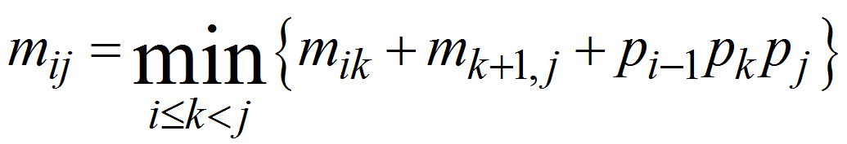
Bottom-up computation
How to choose the order in which we process m_{ij} values?
Before computing m_{ij}, we have to make sure that the values for m_{ik} and m_{k+1,j} have been computed for all k.

Slide 30







1
i
j
n
1
k
m_{ij} must be processed after m_{ik} and m_{j,k+1}
^{m}ik
i
^{m}ij ^{m}k+1,j
k
j
n
Reminder: m_{ij} computed only for j > i

Slide 31
1
i
j
n
1
k
m_{ij} must be processed after m_{ik} and m_{j,k+1}
^{m}ik
^{m}ij ^{m}k+1,j
i
k
How to set up the iterations over i and j to compute m_{ij}?
j
n

Slide 32








1
i
j
n
If the entries m_{ij} are computed in the shown order, then m_{ik} and m_{k+1,j} values are guaranteed to be computed before m_{ij}.
1
i
^{m}ij
j
n

Slide 33












1
j
n
1
j = i+7 j = i+6 j = i+5 j = i+4
j = i+3 j = i+2
j = i+1
i
n

Slide 34
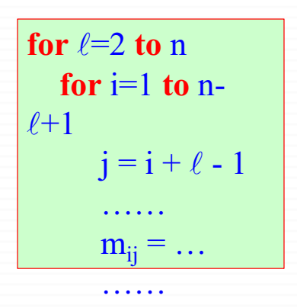

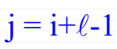
j
1
n
1
for =2 to n
for i=1 to n-
+1
i
j = i +  - 1
j = i+-1
…… m_{ij} = …
……
n

Slide 35
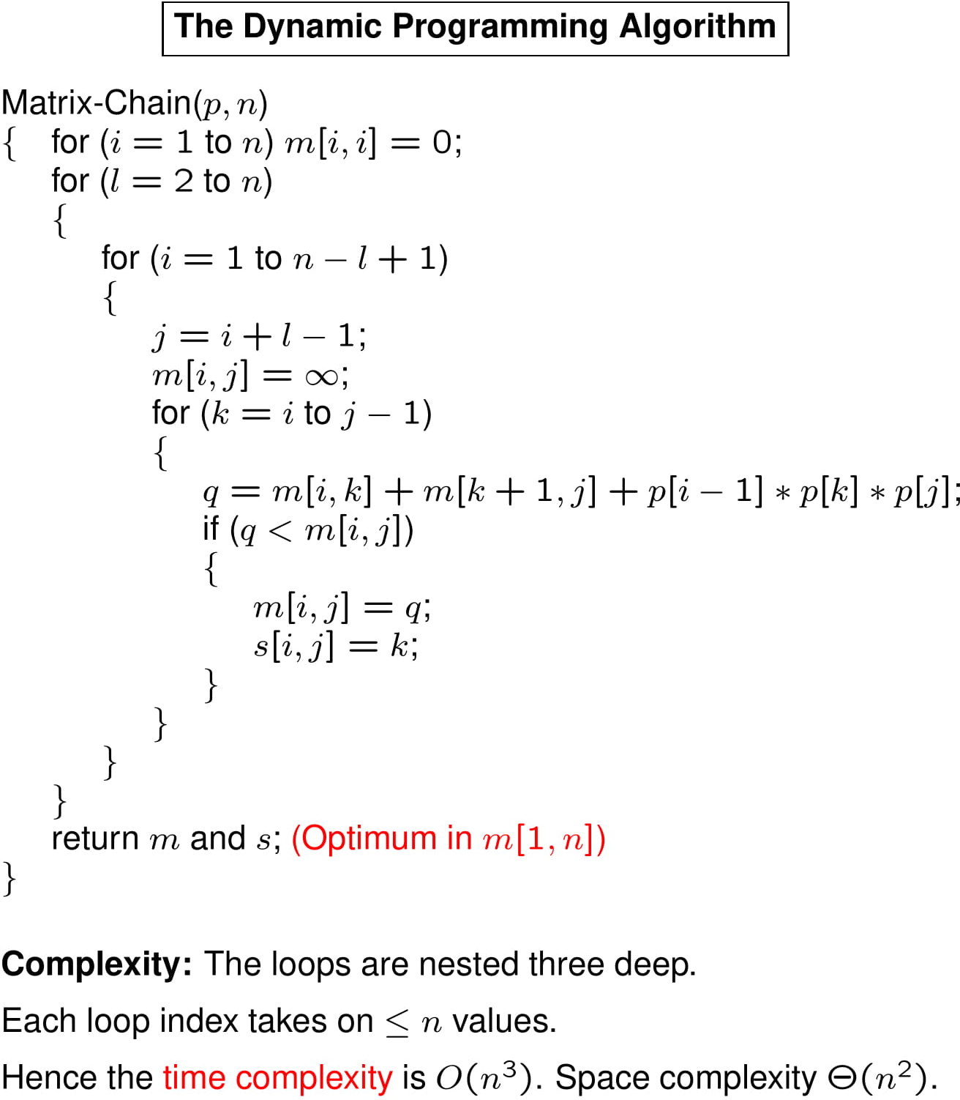

Slide 36
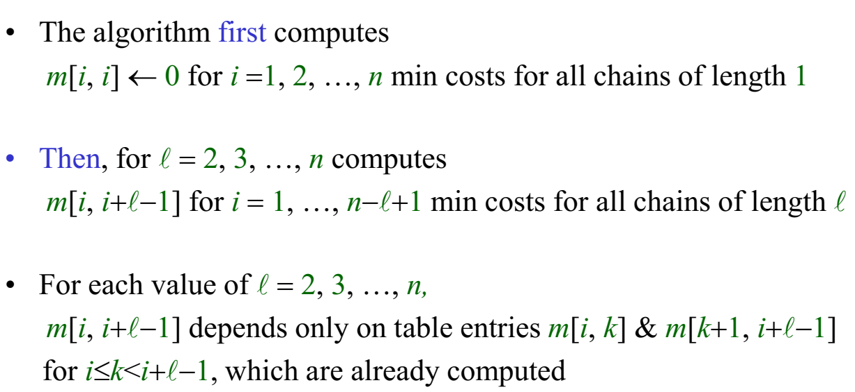
Algorithm for Computing the Optimal Costs
The algorithm first computes
m[i, i] ← 0 for i =1, 2, …, n min costs for all chains of length 1
Then, for  = 2, 3, …, n computes
m[i, i+−1] for i = 1, …, n−+1 min costs for all chains of length 
For each value of  = 2, 3, …, n,
m[i, i+−1] depends only on table entries m[i, k] & m[k+1, i+−1] for i≤k<i+−1, which are already computed

Slide 37
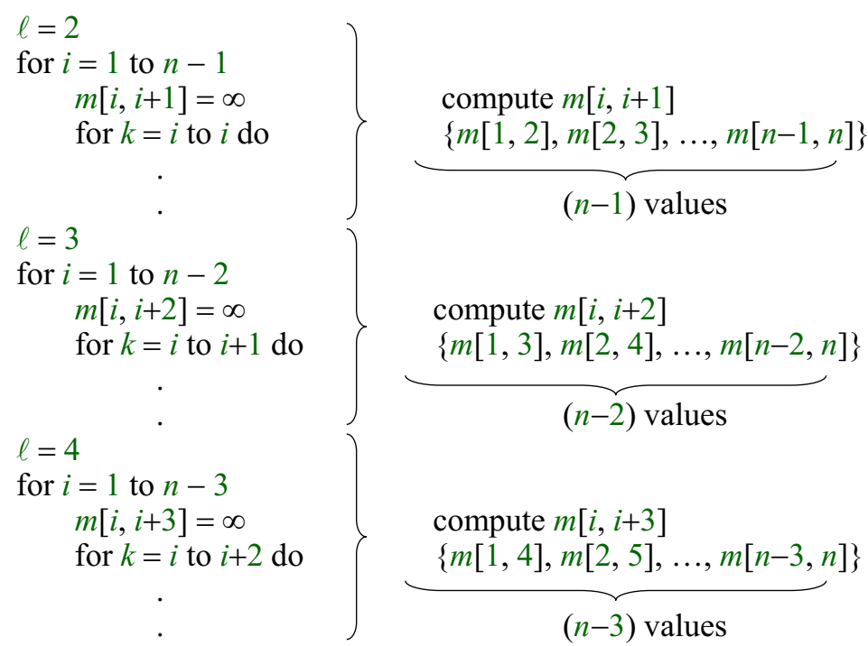
Algorithm for Computing the Optimal Costs
compute m[i, i+1]
{m[1, 2], m[2, 3], …, m[n−1, n]}
(n−1) values
compute m[i, i+2]
{m[1, 3], m[2, 4], …, m[n−2, n]}
(n−2) values
compute m[i, i+3]
{m[1, 4], m[2, 5], …, m[n−3, n]}
(n−3) values

Slide 38
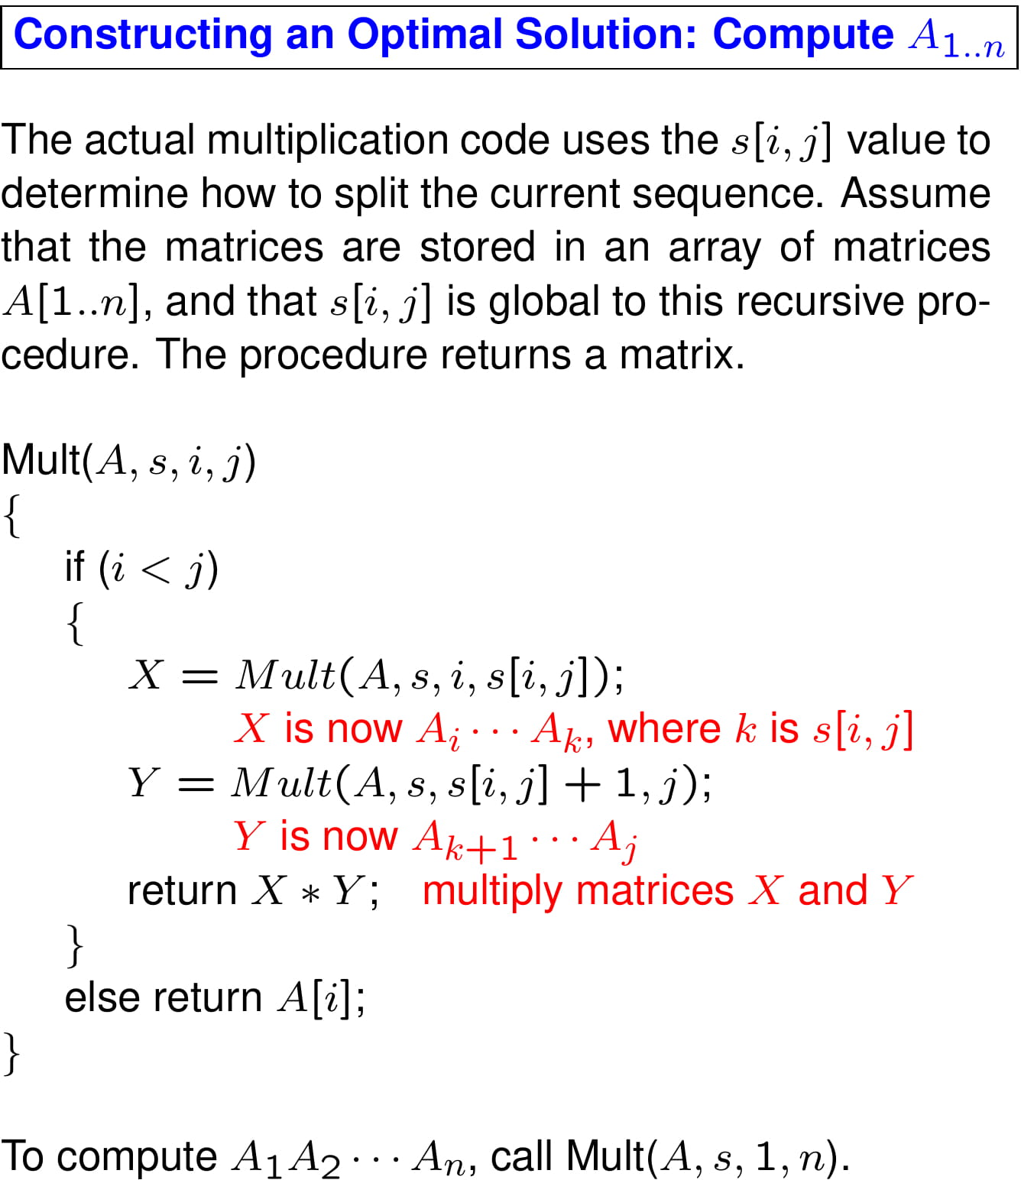

Slide 39
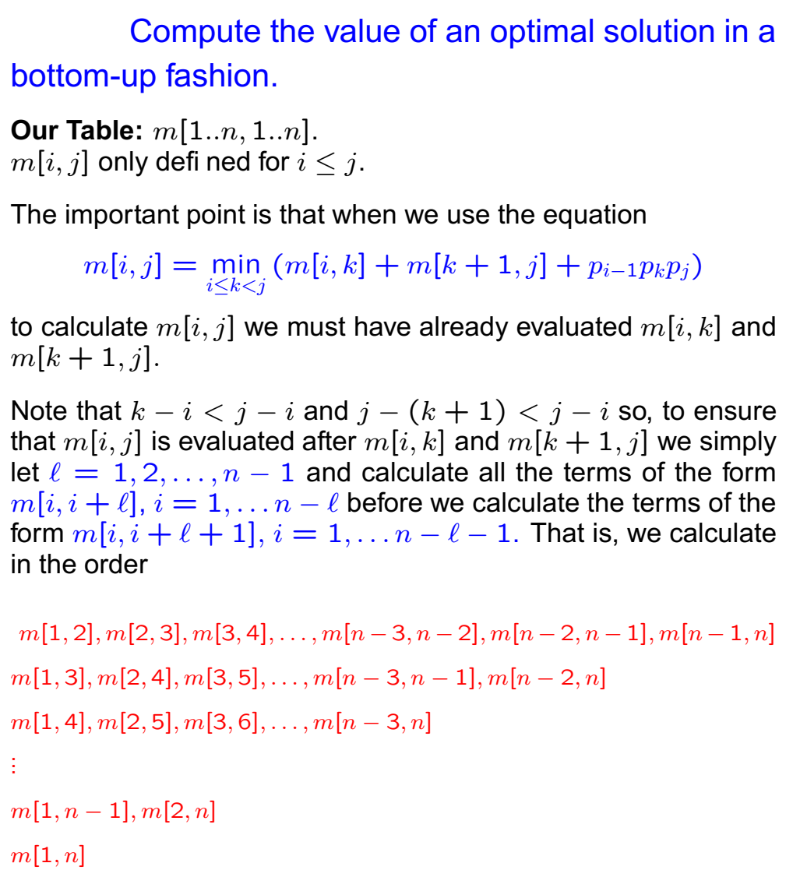
Matrix-chain Multiplication Example by David Mount Professor in the Department of Computer Science and UMIACS.

Slide 40
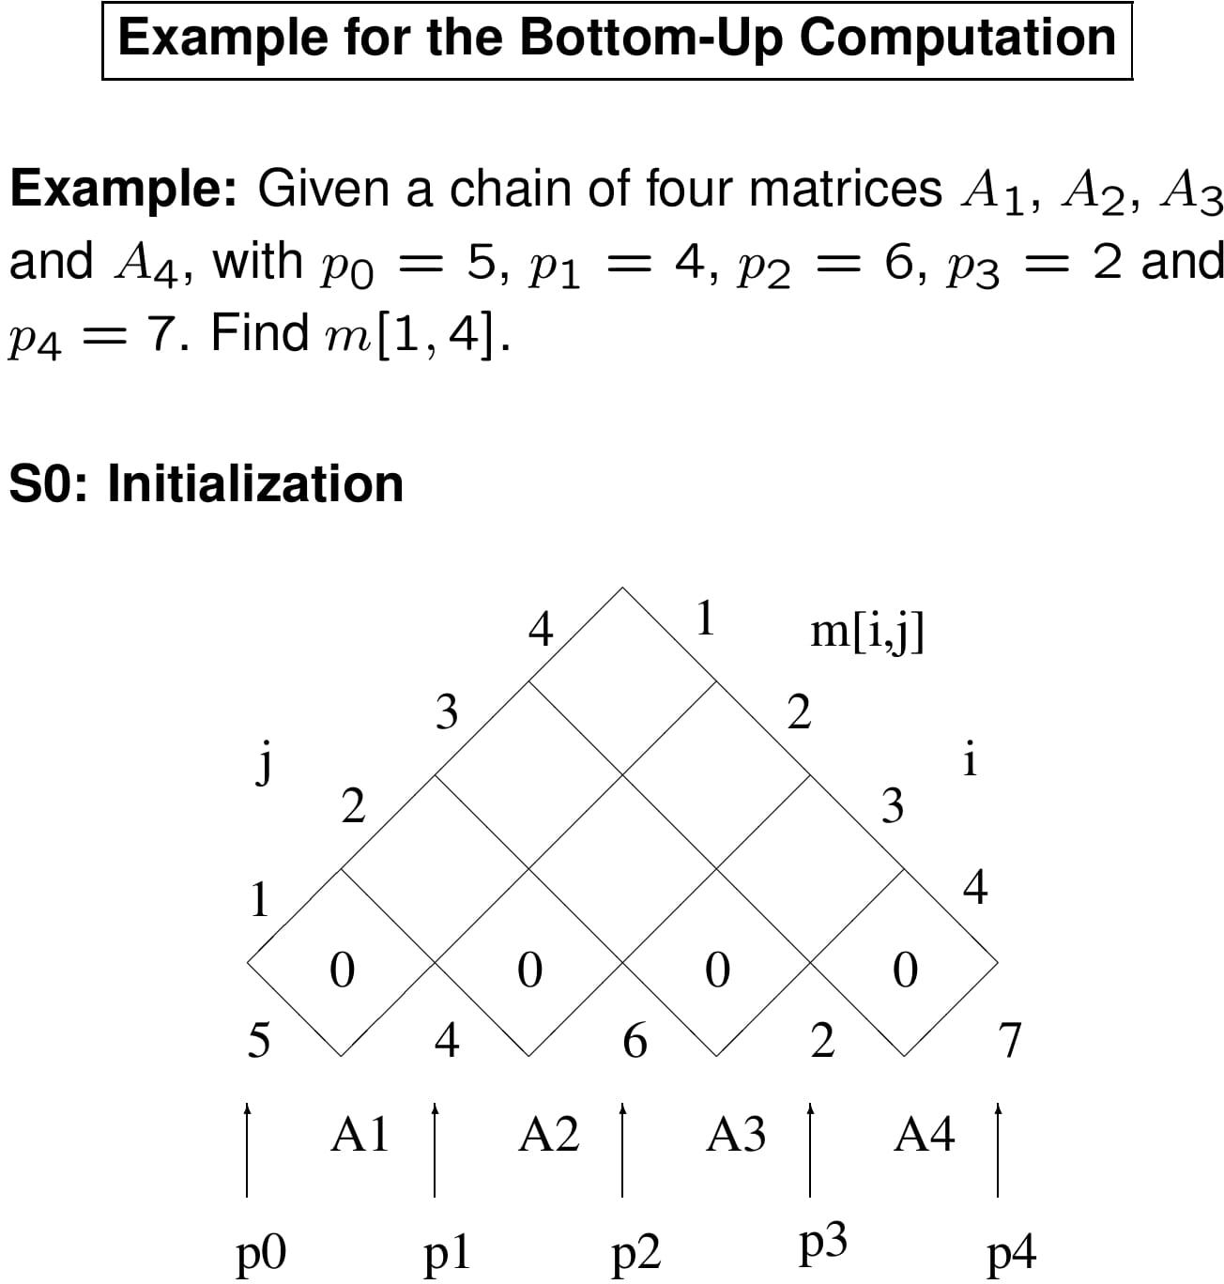

Slide 41
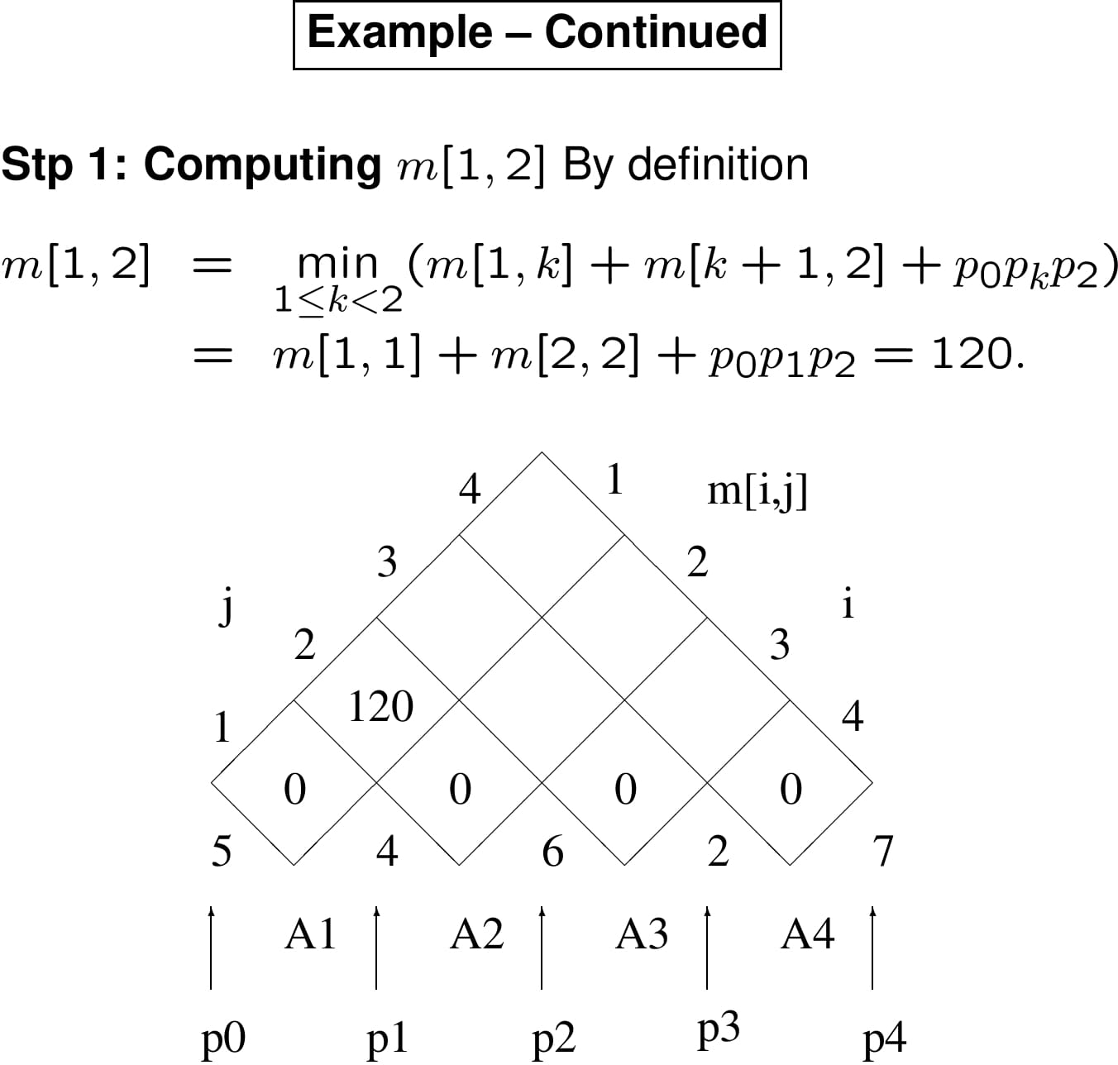

Slide 42
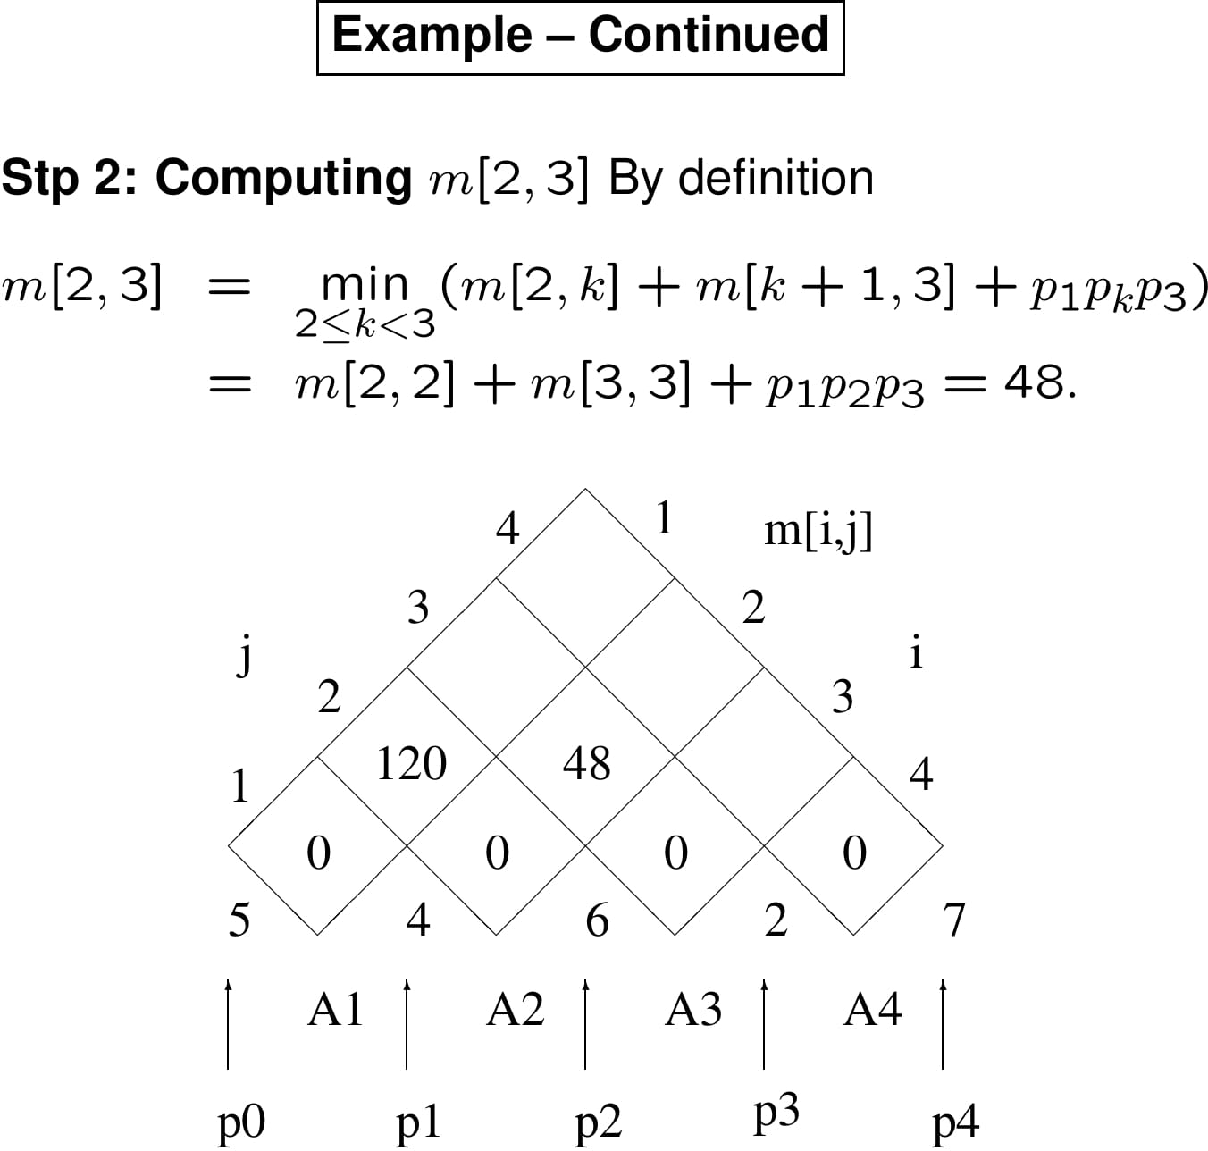

Slide 43
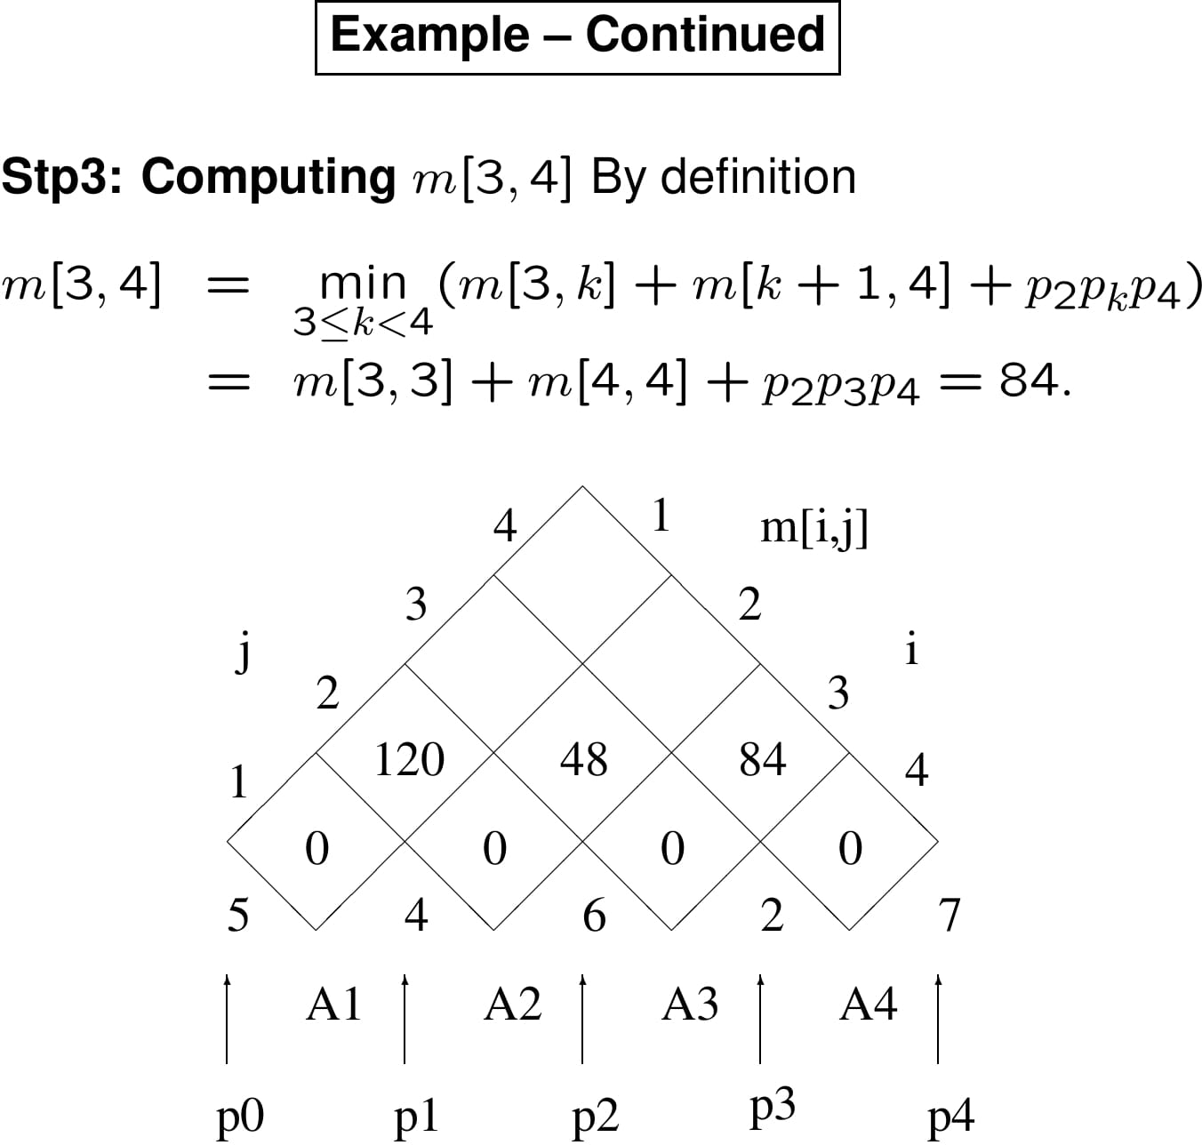

Slide 44
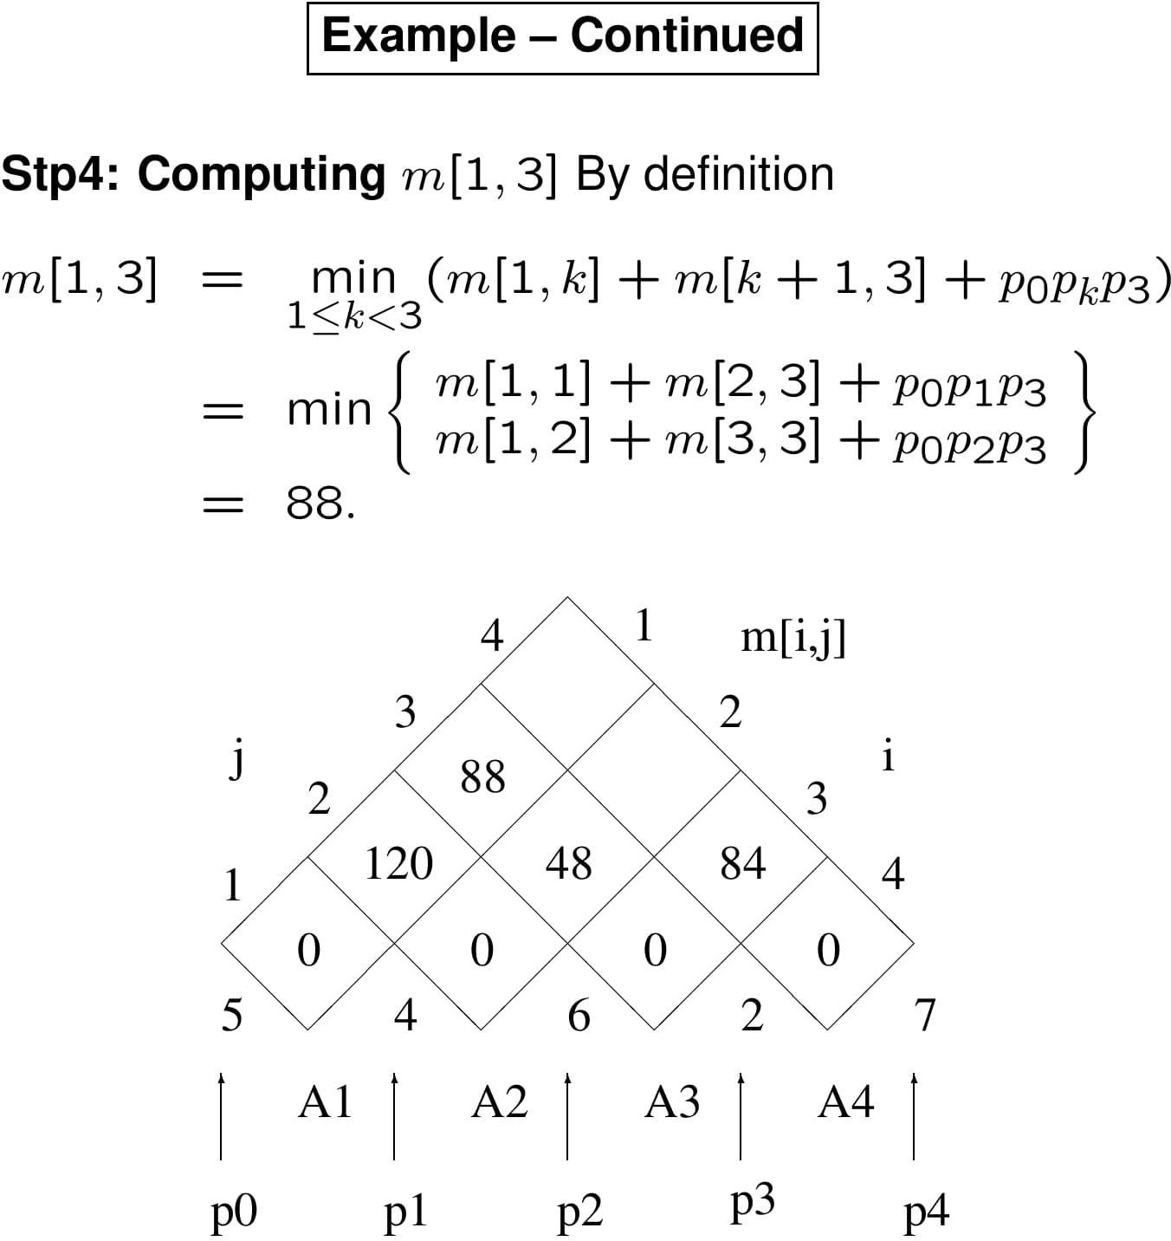

Slide 45
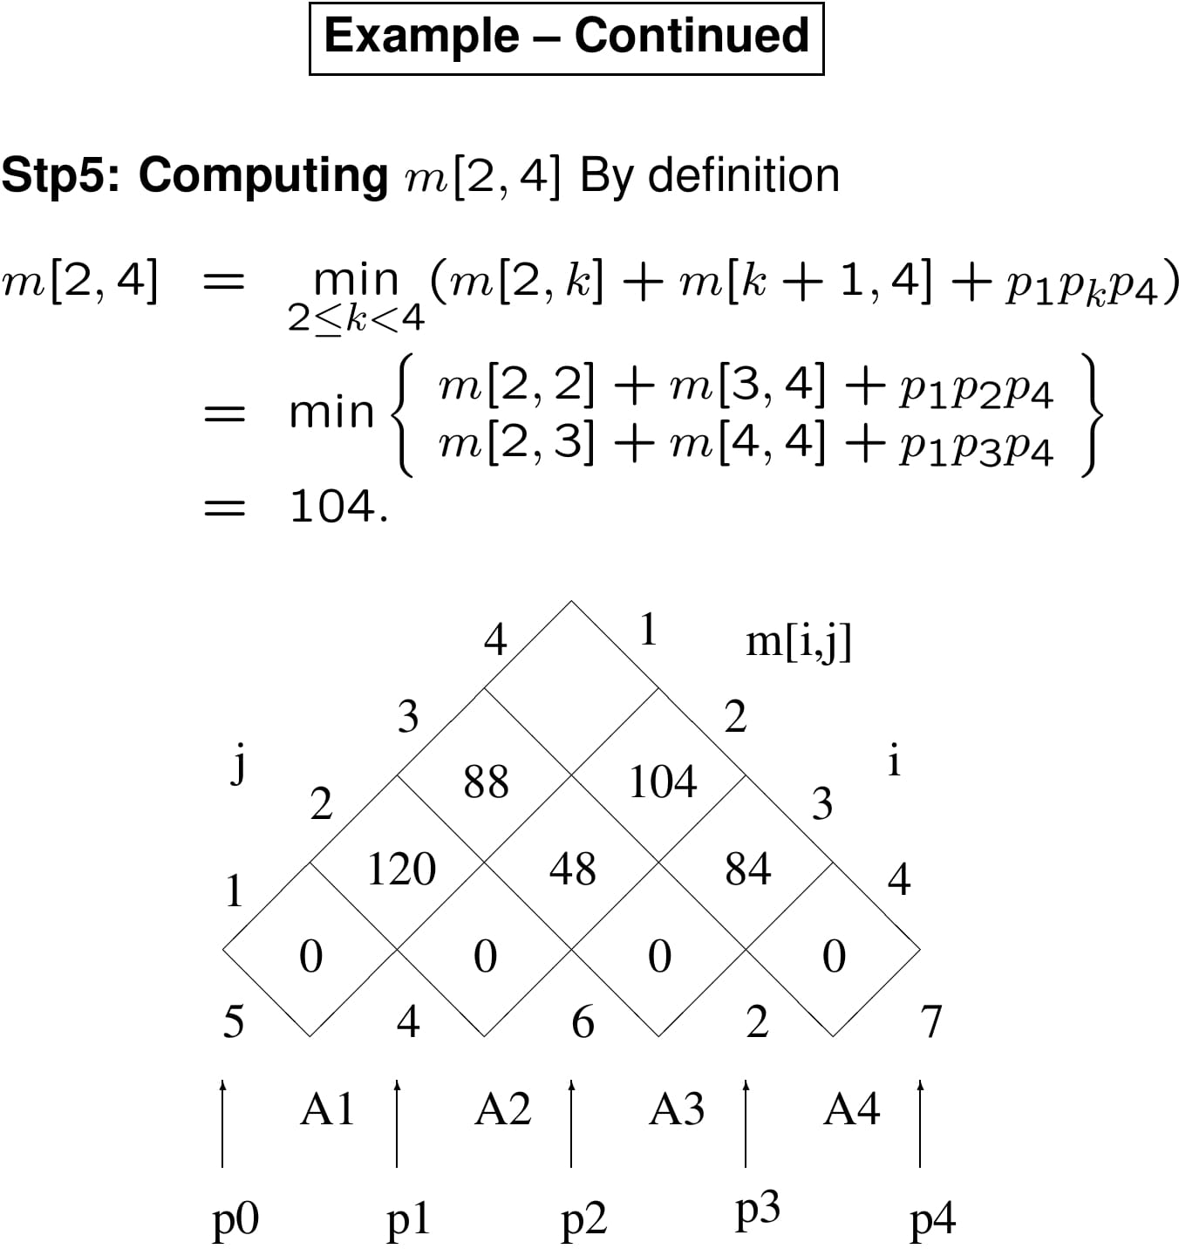

Slide 46
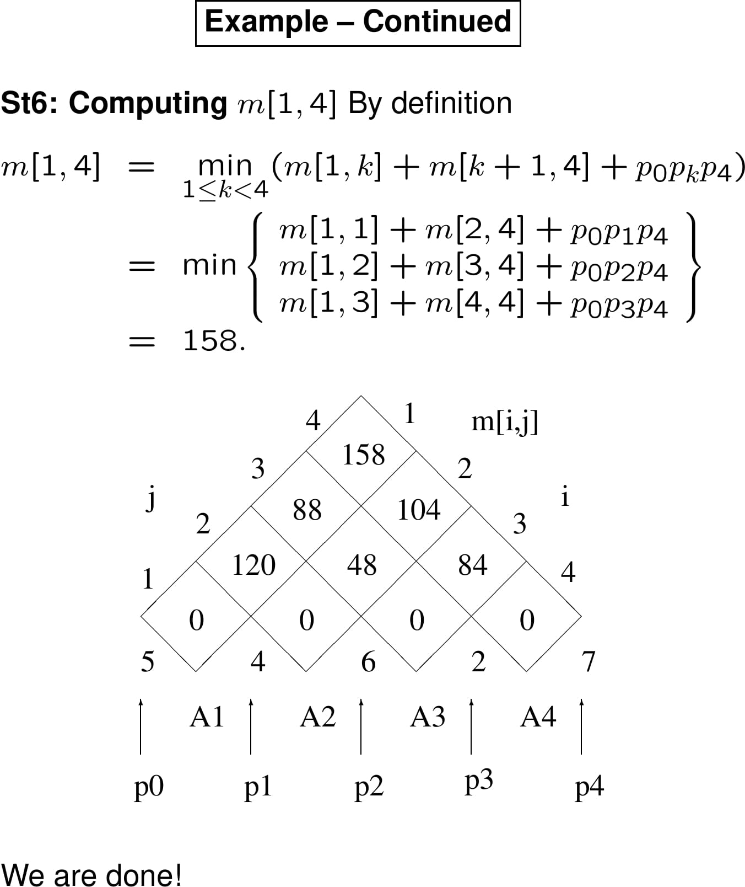

Slide 47
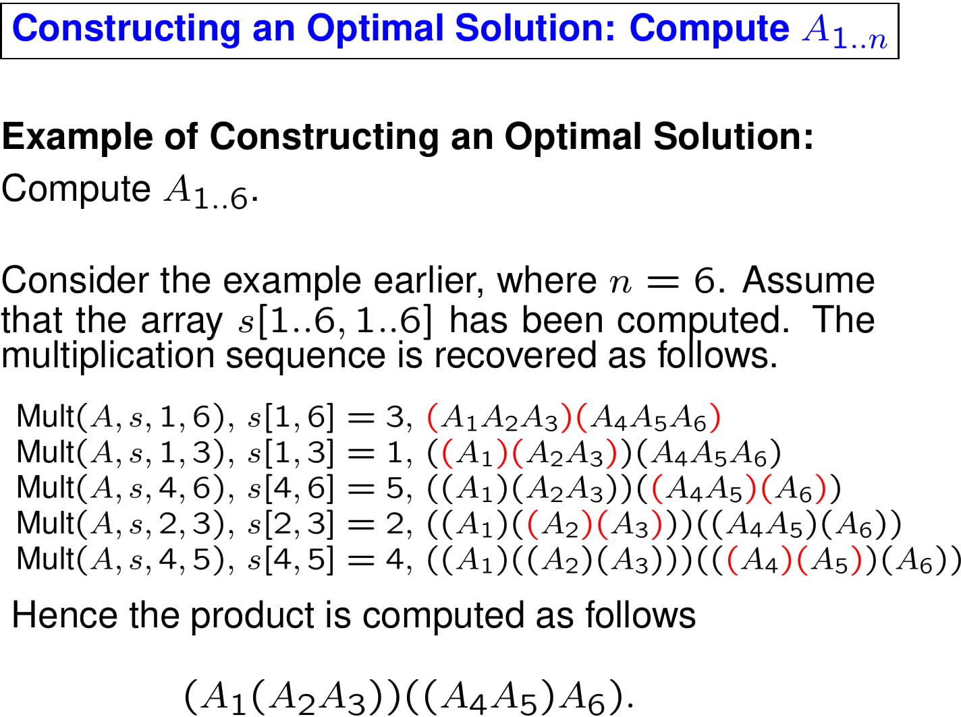

Slide 48
Summary
Identification of the optimal substructure property
Recursive formulation to compute the cost of the optimal solution
Bottom-up computation of the table entries
Constructing the optimal solution by backtracing the table entries

Slide 49
Elements of Dynamic Programming
When should we look for a DP solution to an optimization problem?
Two key ingredients for the problem
Optimal substructure
Overlapping subproblems

Slide 50
DP Hallmark #1
Optimal Substructure
A problem exhibits optimal substructure
– if an optimal solution to a problem contains within it optimal solutions to subproblems
Example: matrix-chain-multiplication
Optimal parenthesization of A₁A₂… A_{n} that splits the product between A_{k} and A_{k+1},
contains within it optimal soln’s to the problems of parenthesizing A₁A₂… A_{k} and A_{k+1}A_{k+2} … A_{n}

Slide 51
Optimal Substructure
Finding a suitable space of subproblems
Iterate on subproblem instances
Example: matrix-chain-multiplication
Iterate and look at the structure of optimal solutions to subproblems, sub-subproblems, and so forth
Discover that all subproblems consists of subchains of
⟨A₁, A₂, … , A_{n}⟩
Thus, the set of chains of the form
⟨A_{i},A_{i+1}, … , A_{j}⟩ for 1≤ i ≤ j ≤ n
Makes a natural and reasonable space of subproblems

Slide 52
DP Hallmark #2
Overlapping Subproblems
Total number of distinct subproblems should be polynomial in the input size
When a recursive algorithm revisits the same problem over and over again we say that the optimization problem has overlapping subproblems

Slide 53
Overlapping Subproblems
DP algorithms typically take advantage of overlapping subproblems
by solving each problem once
then storing the solutions in a table where it can be looked up when needed
using constant time per lookup

Slide 54
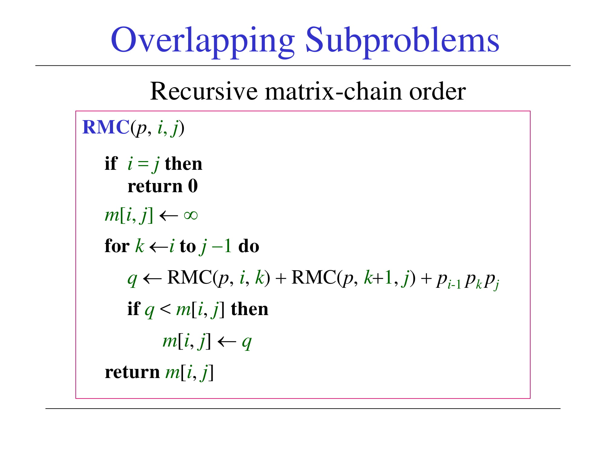
Overlapping Subproblems
Recursive matrix-chain order
RMC(p, i, j)
if i = j then return 0
m[i, j] ← ∞
for k ←i to j −1 do
q ← RMC(p, i, k) + RMC(p, k+1, j) + p_{i-1} p_{k} p_{j}
if q < m[i, j] then
m[i, j] ← q
return m[i, j]

Slide 55
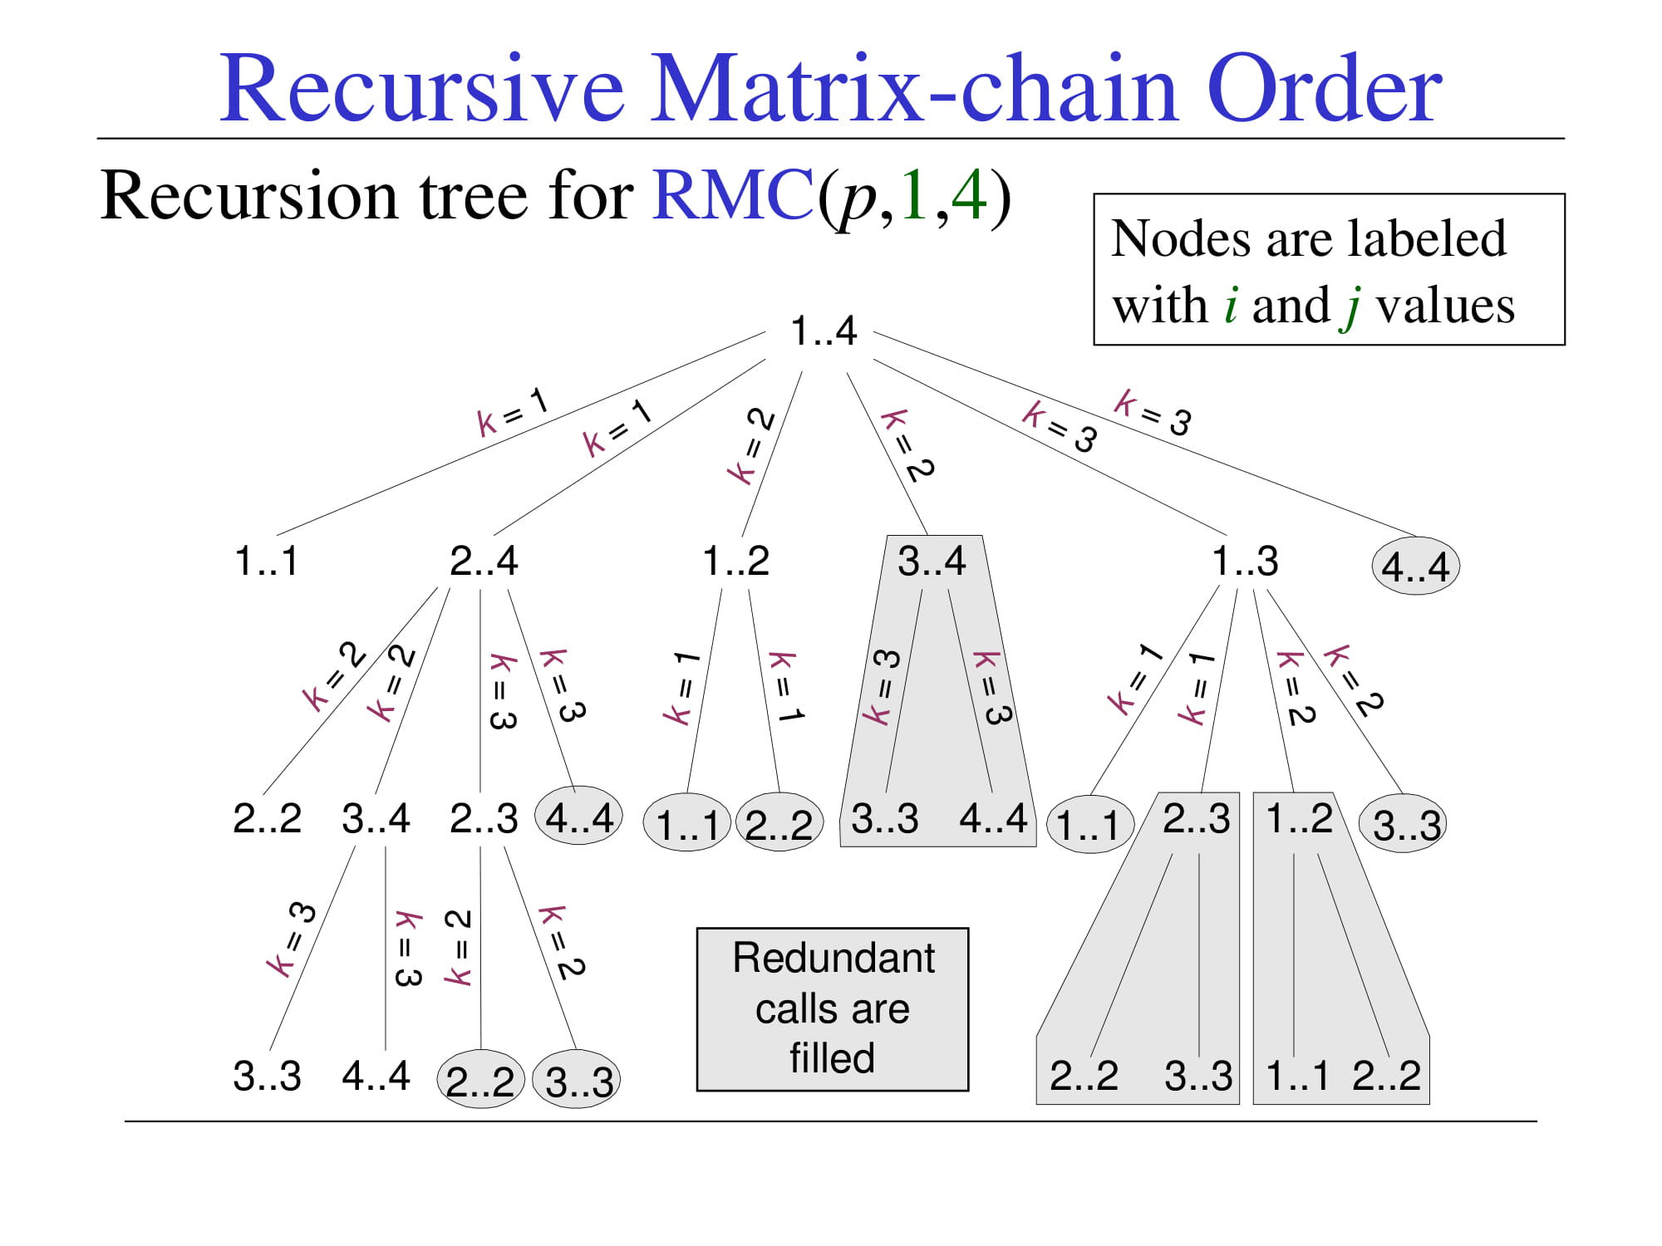
Recursive Matrix-chain Order
Recursion tree for RMC(p,1,4)
Nodes are labeled with i and j values
1..4
k = 1
k = 1
k = 3
k = 3
k = 2
k = 2
1..1
2..4
1..2
3..4
1..3
4..4
k = 2
k = 2
k = 3
k = 3
k = 1
k = 1
k = 3
k = 3
k = 1
k = 1
k = 2
k = 2
2..2
3..4
2..3
4..4
1..1 2..2
3..3
4..4
1..1
2..3
1..2
3..3
k = 3
k = 3
k = 2
k = 2
Redundant calls are filled
3..3
4..4
2..2
3..3
2..2
3..3
1..1 2..2

Slide 56
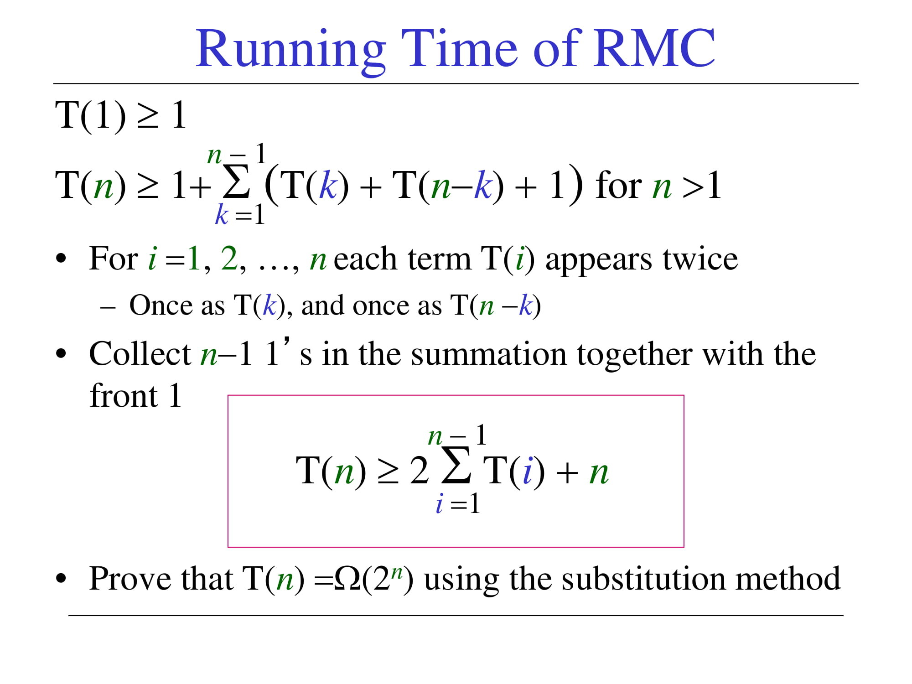
Running Time of RMC
T(1) ≥ 1
n − 1
T(n) ≥ 1+ Σ (T(k) + T(n−k) + 1) for n >1
k =1
For i =1, 2, …, n each term T(i) appears twice
– Once as T(k), and once as T(n −k)
Collect n−1 1’s in the summation together with the
front 1
n − 1
T(n) ≥ 2 Σ T(i) + n
i =1
Prove that T(n) =Ω(2^{n}) using the substitution method

Slide 57
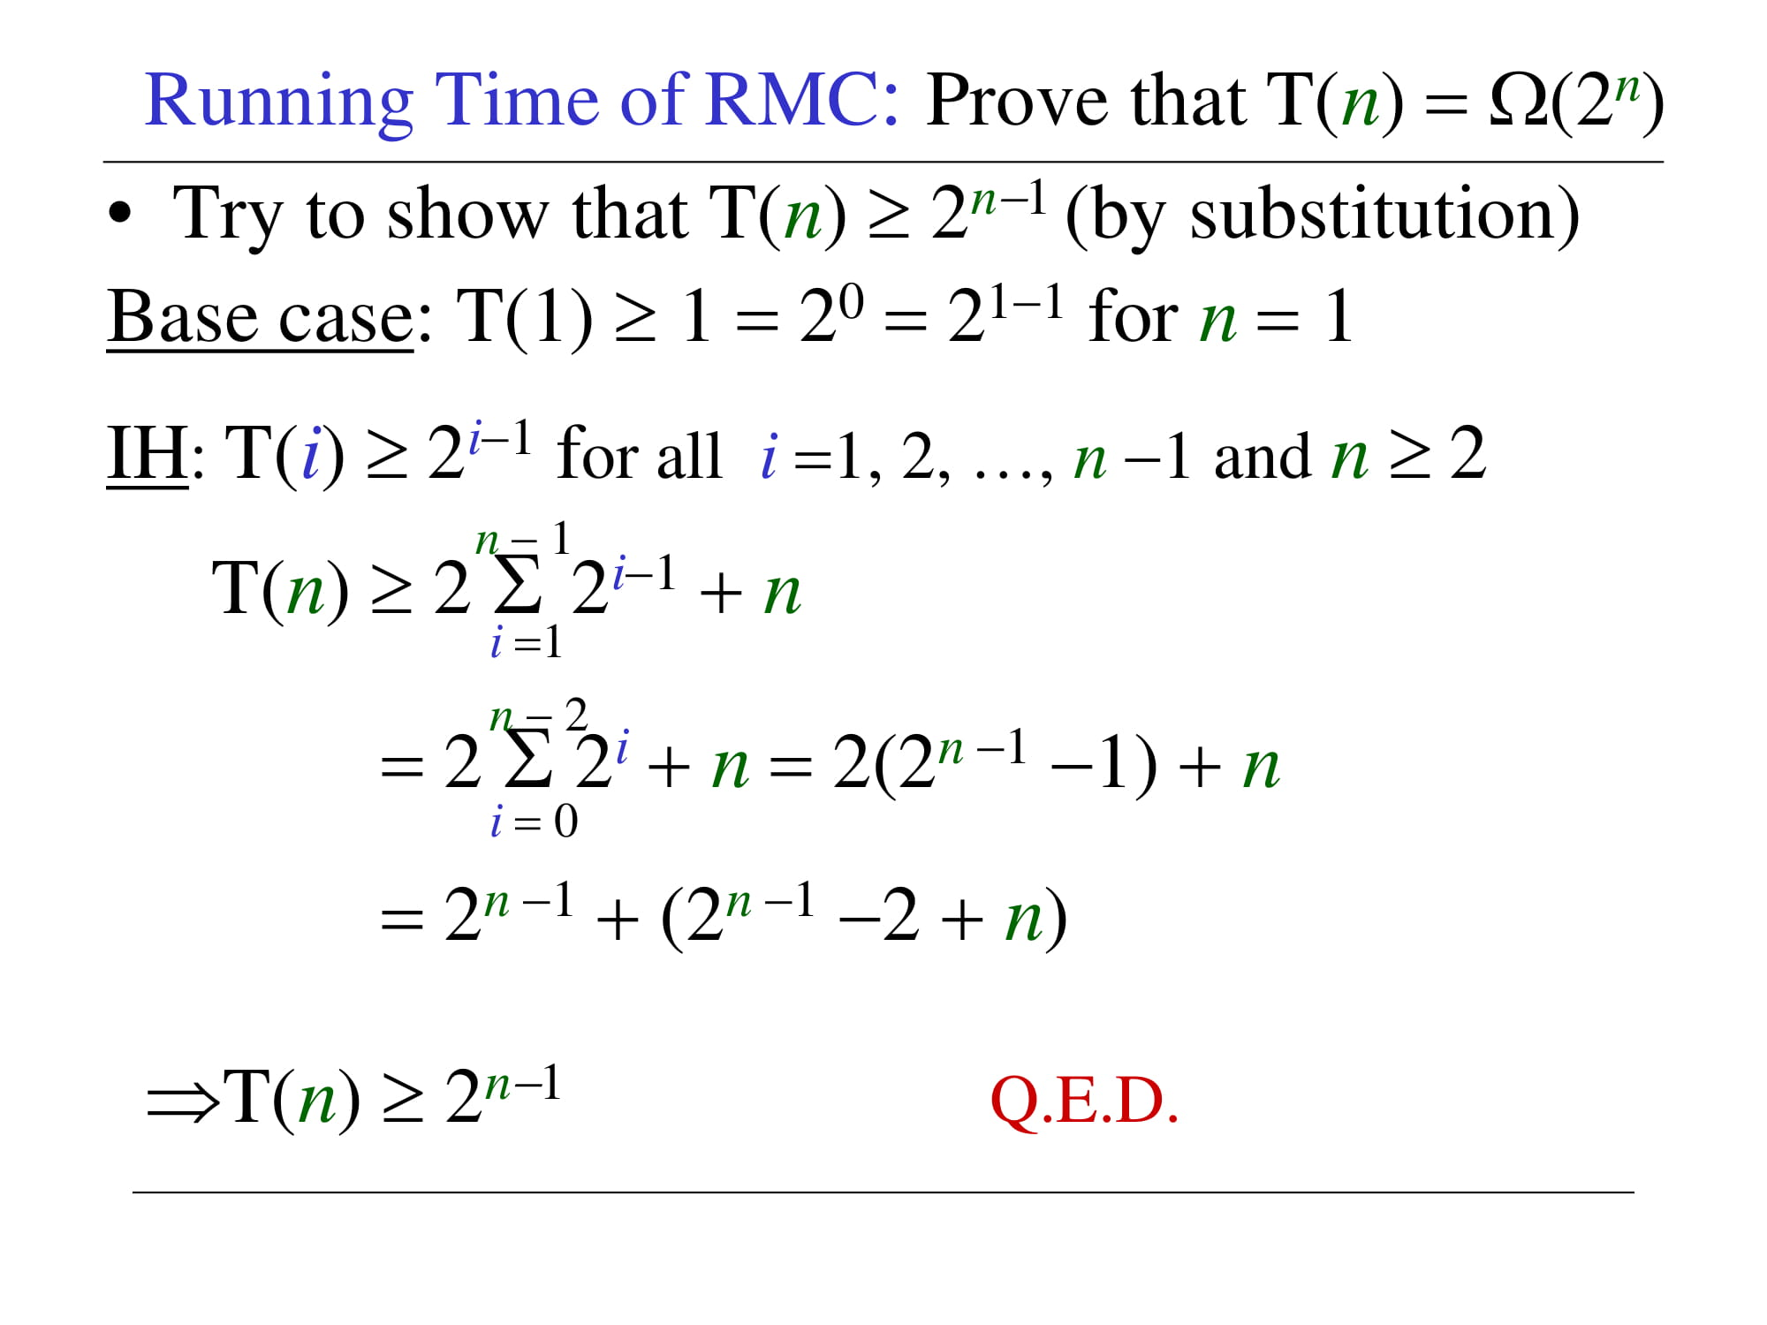
Running Time of RMC: Prove that T(n) = Ω(2^{n})
Try to show that T(n) ≥ 2^{n−1} (by substitution) Base case: T(1) ≥ 1 = 2⁰ = 2¹⁻¹ for n = 1
IH: T(i) ≥ 2^{i−1} for all i =1, 2, …, n −1 and n ≥ 2
n − 1
T(n) ≥ 2 Σ 2^{i−1} + n
i =1
n − 2
= 2 Σ 2^{i} + n = 2(2^{n −1} −1) + n
i = 0
= 2^{n −1} + (2^{n −1} −2 + n)
⇒T(n) ≥ 2^{n−1}
Q.E.D.

Slide 58
Running Time of RMC: T(n) ≥ 2^{n−1}
Whenever
a recursion tree for the natural recursive solution to a problem contains the same subproblem repeatedly
the total number of different subproblems is small
it is a good idea to see if DP can be applied

Slide 59
Memoization
Offers the efficiency of the usual DP approach while maintaining top-down strategy
Idea is to memoize the natural, but inefficient, recursive algorithm

Slide 60
Memoized Recursive Algorithm
Maintains an entry in a table for the solution to each subproblem
Each table entry contains a special value to indicate that the entry has yet to be filled in
When the subproblem is first encountered its solution is computed and then stored in the table
Each subsequent time that the subproblem encountered the value stored in the table is simply looked up and returned

Slide 61
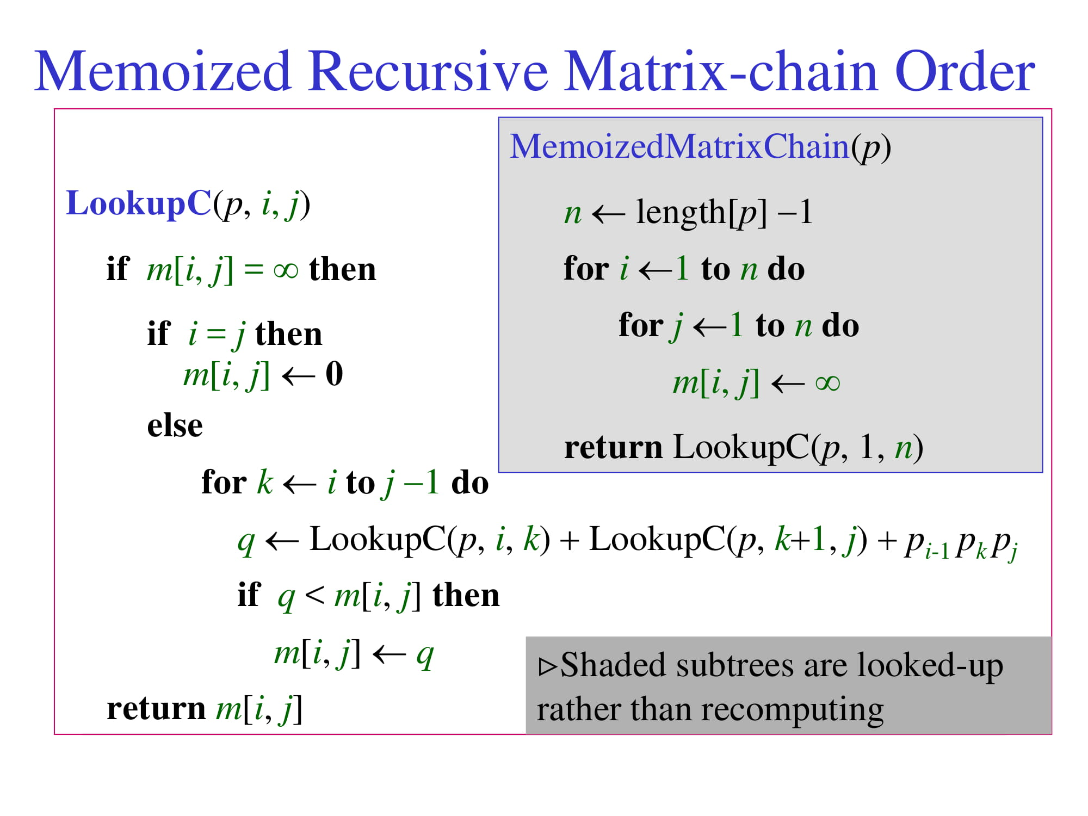
Memoized Recursive Matrix-chain Order
MemoizedMatrixChain(p)
n ← length[p] −1
for i ←1 to n do
for j ←1 to n do
m[i, j] ← ∞
return LookupC(p, 1, n)
LookupC(p, i, j)
if m[i, j] = ∞ then if i = j then
m[i, j] ← 0
else
for k ← i to j −1 do
q ← LookupC(p, i, k) + LookupC(p, k+1, j) + p_{i-1} p_{k} p_{j}
if q < m[i, j] then
m[i, j] ← q
return m[i, j]
Shaded subtrees are looked-up rather than recomputing

Slide 62
Memoized Recursive Algorithm
The approach assumes that
The set of all possible subproblem parameters are known
The relation between the table positions and subproblems is established
Another approach is to memoize
by using hashing with subproblem parameters as key

Slide 63
Dynamic Programming vs Memoization Summary
Matrix-chain multiplication can be solved in O(n³) time
by either a top-down memoized recursive algorithm
or a bottom-up dynamic programming algorithm
Both methods exploit the overlapping subproblems property
There are only Θ(n²) different subproblems in total
Both methods compute the solution to each problem once
Without memoization the natural recursive algorithm runs in exponential time since subproblems are solved repeatedly

Slide 64
Dynamic Programming vs Memoization Summary
In general practice
If all subproblems must be solved at once
a bottom-up DP algorithm always outperforms a top-down memoized algorithm by a constant factor
because, bottom-up DP algorithm
Has no overhead for recursion
Less overhead for maintaining the table
DP: Regular pattern of table accesses can be exploited to reduce the time and/or space requirements even further
Memoized: If some problems need not be solved at all, it has the advantage of avoiding solutions to those subproblems

Slide 65

The Longest Common Subsequence (LCS) Problem
Given two strings X and Y, the longest common subsequence (LCS) problem is to find a longest subsequence common to both X and Y
Has applications to DNA similarity testing (alphabet is {A,C,G,T})
Example: ABCDEFG and XZACKDFWGH have ACDFG as a longest common subsequence
Source: 2004 Goodrich, Tamassia

Slide 66
A Poor Approach to the LCS Problem
A Brute-force solution:
Enumerate all subsequences of X
Test which ones are also subsequences of Y
Pick the longest one.
Analysis:
If X is of length n, then it has 2^{n} subsequences
This is an exponential-time algorithm!

Slide 67
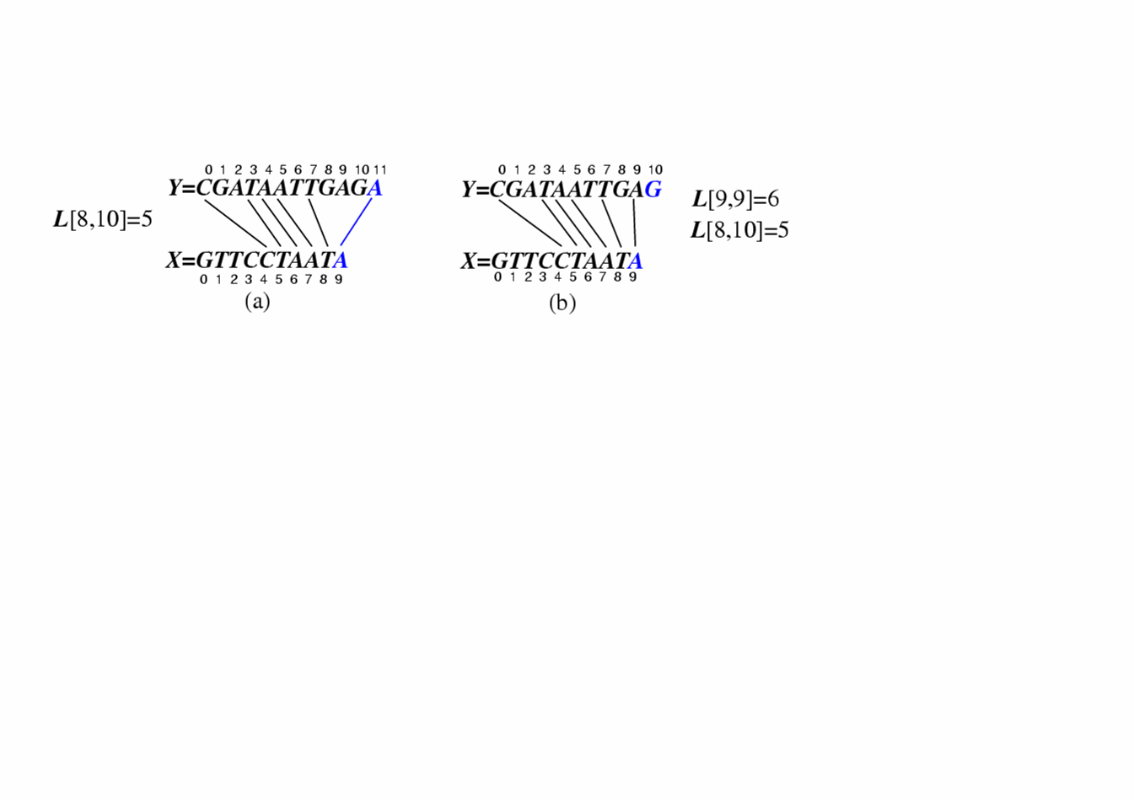
A Dynamic-Programming Approach to the LCS Problem
Define L[i,j] to be the length of the longest common subsequence of X[0..i] and Y[0..j].
Allow for -1 as an index, so L[-1,k] = 0 and L[k,-1]=0, to indicate that the null part of X or Y has no match with the other.
Then we can define L[i,j] in the general case as follows:
If xi=yj, then L[i,j] = L[i-1,j-1] + 1 (we can add this match)
If xi≠yj, then L[i,j] = max{L[i-1,j], L[i,j-1]} (we have no match here)
Case 1:
Case 2:

Slide 68
An LCS Algorithm
Algorithm LCS(X,Y ):
Input: Strings X and Y with n and m elements, respectively
Output: For i = 0,…,n-1, j = 0,...,m-1, the length L[i, j] of a longest string that is a subsequence of both the string X[0..i] = x₀x₁x₂…x_{i} and the string Y [0.. j] = y₀y₁y₂…y_{j}
for i =1 to n-1 do
L[i,-1] = 0
for j =0 to m-1 do
L[-1,j] = 0
for i =0 to n-1 do
for j =0 to m-1 do
if x_{i} = y_{j} then
L[i, j] = L[i-1, j-1] + 1
else
L[i, j] = max{L[i-1, j] , L[i, j-1]}
return array L

Slide 69
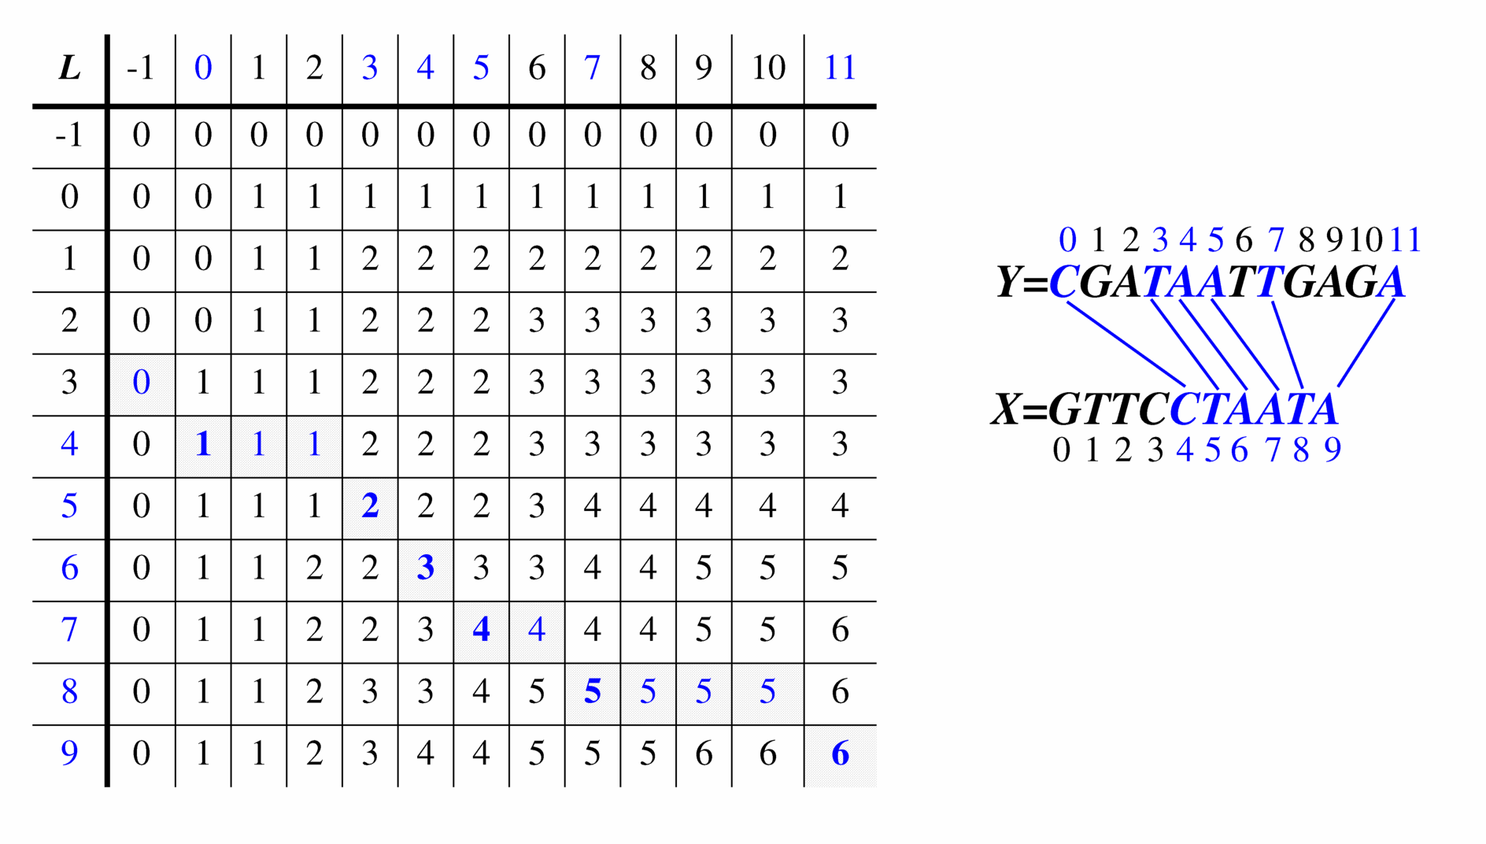
Visualizing the LCS Algorithm

Slide 70
Analysis of LCS Algorithm
We have two nested loops
The outer one iterates n times
The inner one iterates m times
A constant amount of work is done inside each iteration of the inner loop
Thus, the total running time is O(nm)
Answer is contained in L[n,m] (and the subsequence can be recovered from the L table).

